Slide 1
Accurate coding and documentation help your patients and your practice

Slide 2


Improve practice performance
Medicare Advantage (MA)
  An alternative way for patients to receive their Medicare benefits through private insurance plans
  Provides patients with a broader range of benefits and resources compared to Original Medicare
  Provides all protections and standards set by Medicare
  Covers more diverse, medically complex and socially at-risk patients than Original Medicare
Accurate coding and documentation are critical to risk adjustment, giving you valuable resources for patient care and improving practice performance. Here’s how it works.
Risk adjustment
  Promotes fairness and equity in the MA program
  Ensures the appropriate funding is available so providers can execute care plans
  Discourages health plans from not enrolling patients with complex medical needs
Confidential – Do not distribute. © 2024 Vatica Health
2

Slide 3





Risk adjustment in Medicare Advantage
Patients receive their Medicare benefits via private health plans.
The Centers for Medicare and Medicaid Services (CMS) pays plans based on health status of each member.
Health status is based on demographic and disease factors. Disease factors based on provider coding.
Confidential – Do not distribute. © 2024 Vatica Health
3
Notes:
Here’s what I had in mind for todays call.
We will start off with an overview of Vatica, what we do, how we do it, and opportunities to drive additional revenue for your organization.
We’ve pulled some of your performance data that is shared with us by the health plans and we will walk through exactly how we help right size benchmarks, how the workflow impacts prevalence and specificity, HCC capture, gap closure and quality scores through risk adjustment and HEDIS accuracy.
We will spend some time walking through the workflow
Naturally, you’re going to have questions about us, I will have some questions for you. feel free to ask as we go, no need to wait until the end,
At the end of this call, hopefully the outcome is you find this conversation and our solution compelling enough that we can align on next steps.
Does that work for you as well?

Slide 4



Accurate coding matters
  Financial implications
  Under/overpayments or under/overbilling
  Compliance issues
  Legal liabilities, fines and reputational damage
  Compromised care
  Incorrect treatment decisions, delays or unnecessary procedures
  Healthcare system inefficiencies
  Claim denials and payment delays
Hierarchical Condition Category (HCC) coding is distinct from office visit coding, grouping similar diagnoses into categories for risk adjustment payment models.
HCC coding should provide accurate and comprehensive information about health status. Inaccurate coding can have significant impact on providers and patients.
Confidential – Do not distribute. © 2024 Vatica Health
4

Slide 5


Better risk adjustment benefits everyone
Patients
Providers
Medicare Advantage plans offer additional benefits not covered by Original Medicare
97% offer vision benefits
91% offer dental benefits
94% offer hearing benefits
94% offer wellness or fitness benefits
More efficient care than Original Medicare
49% lower rate of long-term acute care hospital stays
13% lower in-patient hospitalization costs
43% lower rate of potentially avoidable hospitalizations
$1,965 less in total annual out-of-pocket spending
Highly satisfied patients
98% of beneficiaries stay with Medicare Advantage plans, due in part to long-term relationships with their providers
Identify, report and close care gaps
Better coding supports proactive identification of patient needs and targeted interventions
Offer programs not covered by Original Medicare
Care management programs like disease and medication management, lifestyle coaching and preventive screenings give providers an extra hand in caring for patients with complex conditions
Source: Better Medicare Alliance

Slide 6
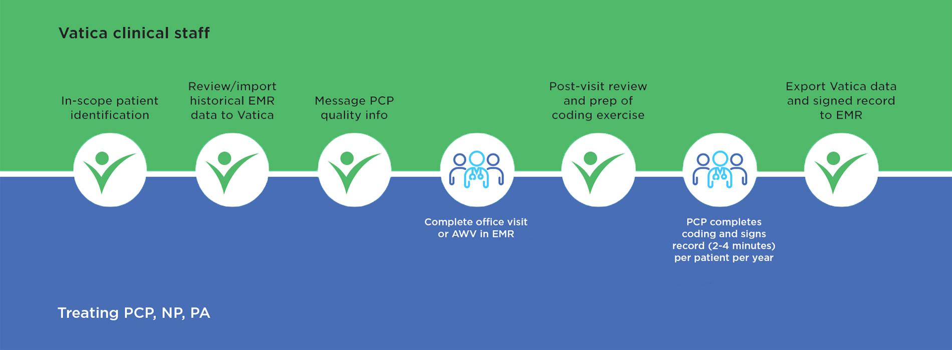
Vatica can help
Clinical teams plus user-friendly technology at point of care help providers capture more accurate and complete diagnostic codes
Accurate code capture results in appropriate CMS reimbursement, ensuring adequate resources based on patient’s health status
Providers are fairly compensated for the patient populations they treat
Providers working with Vatica receive additional incentive for each completed visit. Provider use funding to hire staff and provide services such as care management, behavioral health and enhanced pharmacy services.
Our dedicated clinical staff supports PCPs

